Slide 1
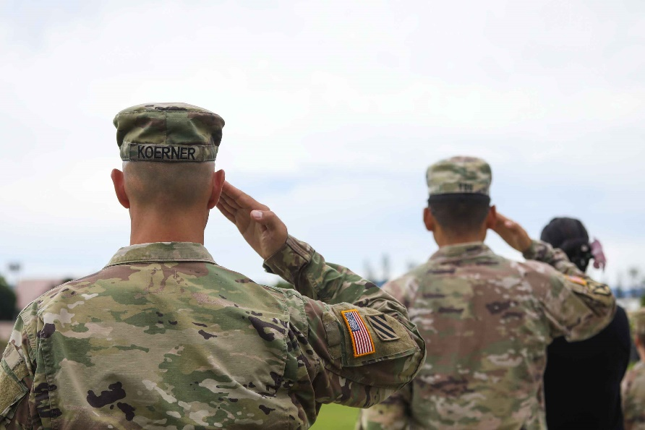
All about the Army
By Chase

Slide 2
Breathing x3
Breathe in through the nose…hold for 3 seconds…and breathe out slowly and quietly through the mouth.

Slide 3
Ask permission to touch your partner

Slide 4
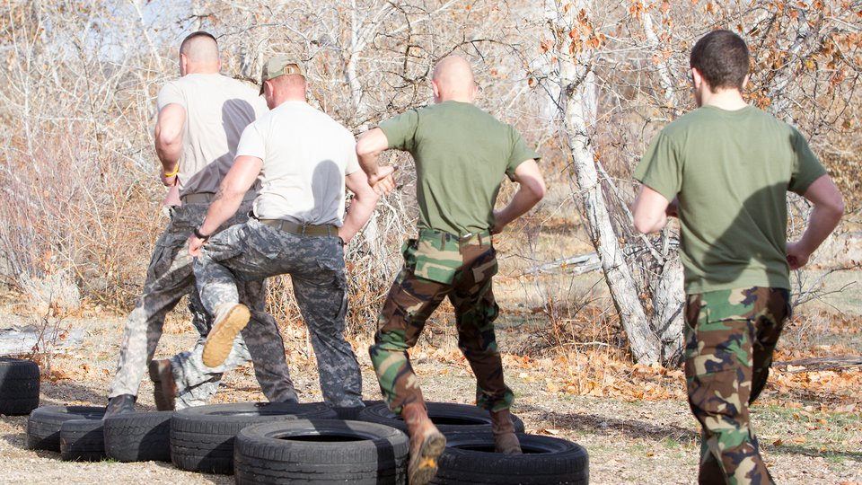
The Calm
The army is where the troops go train.

Slide 5
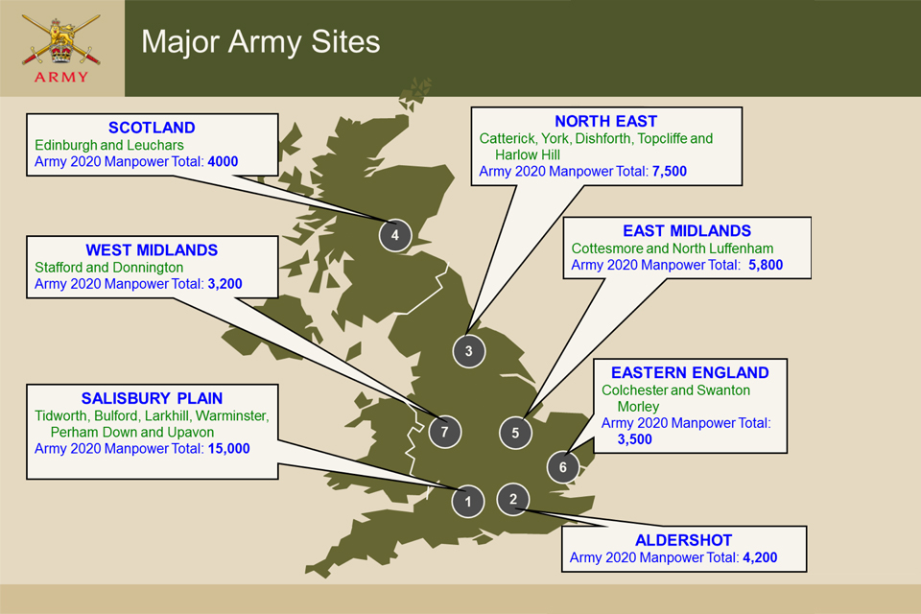
The Claw
There are different base camps across the UK.

Slide 6
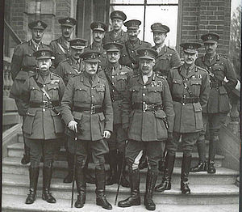
The Fan
During WW1, a British soldier had to be 19 years old to serve overseas but many lied about their age.
About 250,000 under-age boys served. The youngest was discovered to be just 12.

Slide 7
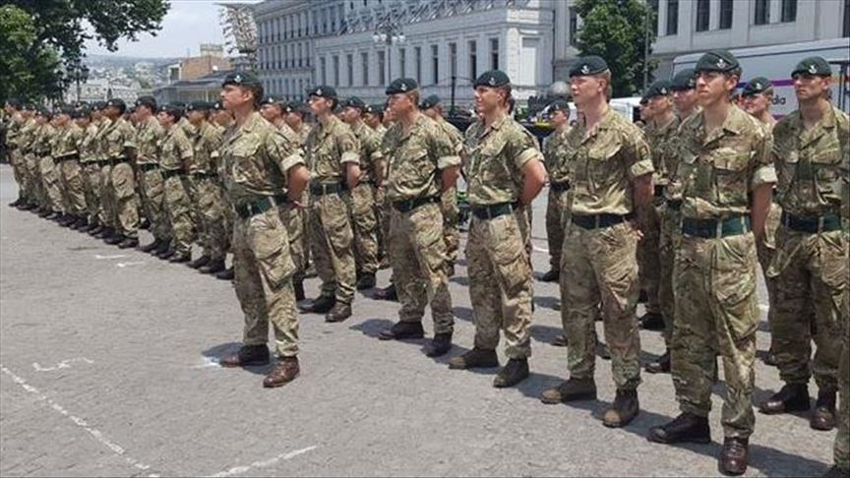
The Walk
As of 2020, the British Army has 80,040 full-time troops.

Slide 8
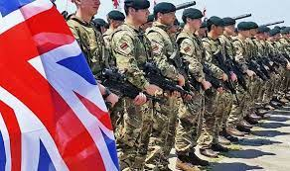
The Circle
The British Army protects the United Kingdom's interests at home and abroad, providing a safe and secure environment in which all British citizens can live and do well.

Slide 9
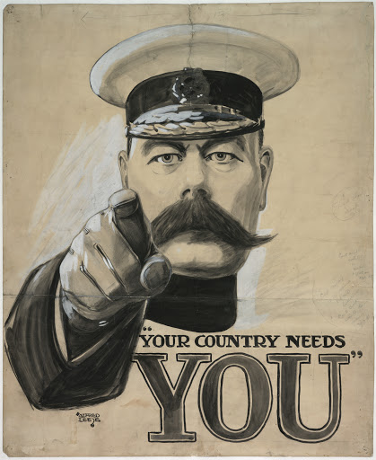
The Drum
The minimum age to apply in the UK to join the army is 16.
The UK is the only country in Europe which routinely recruits people aged under 18.
Those who sign on when 16 or 17 must serve until they are 22.

Slide 10
Say thank you to each other!

