Slide 1
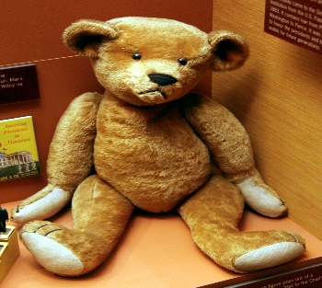
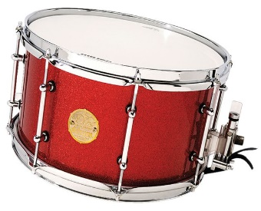
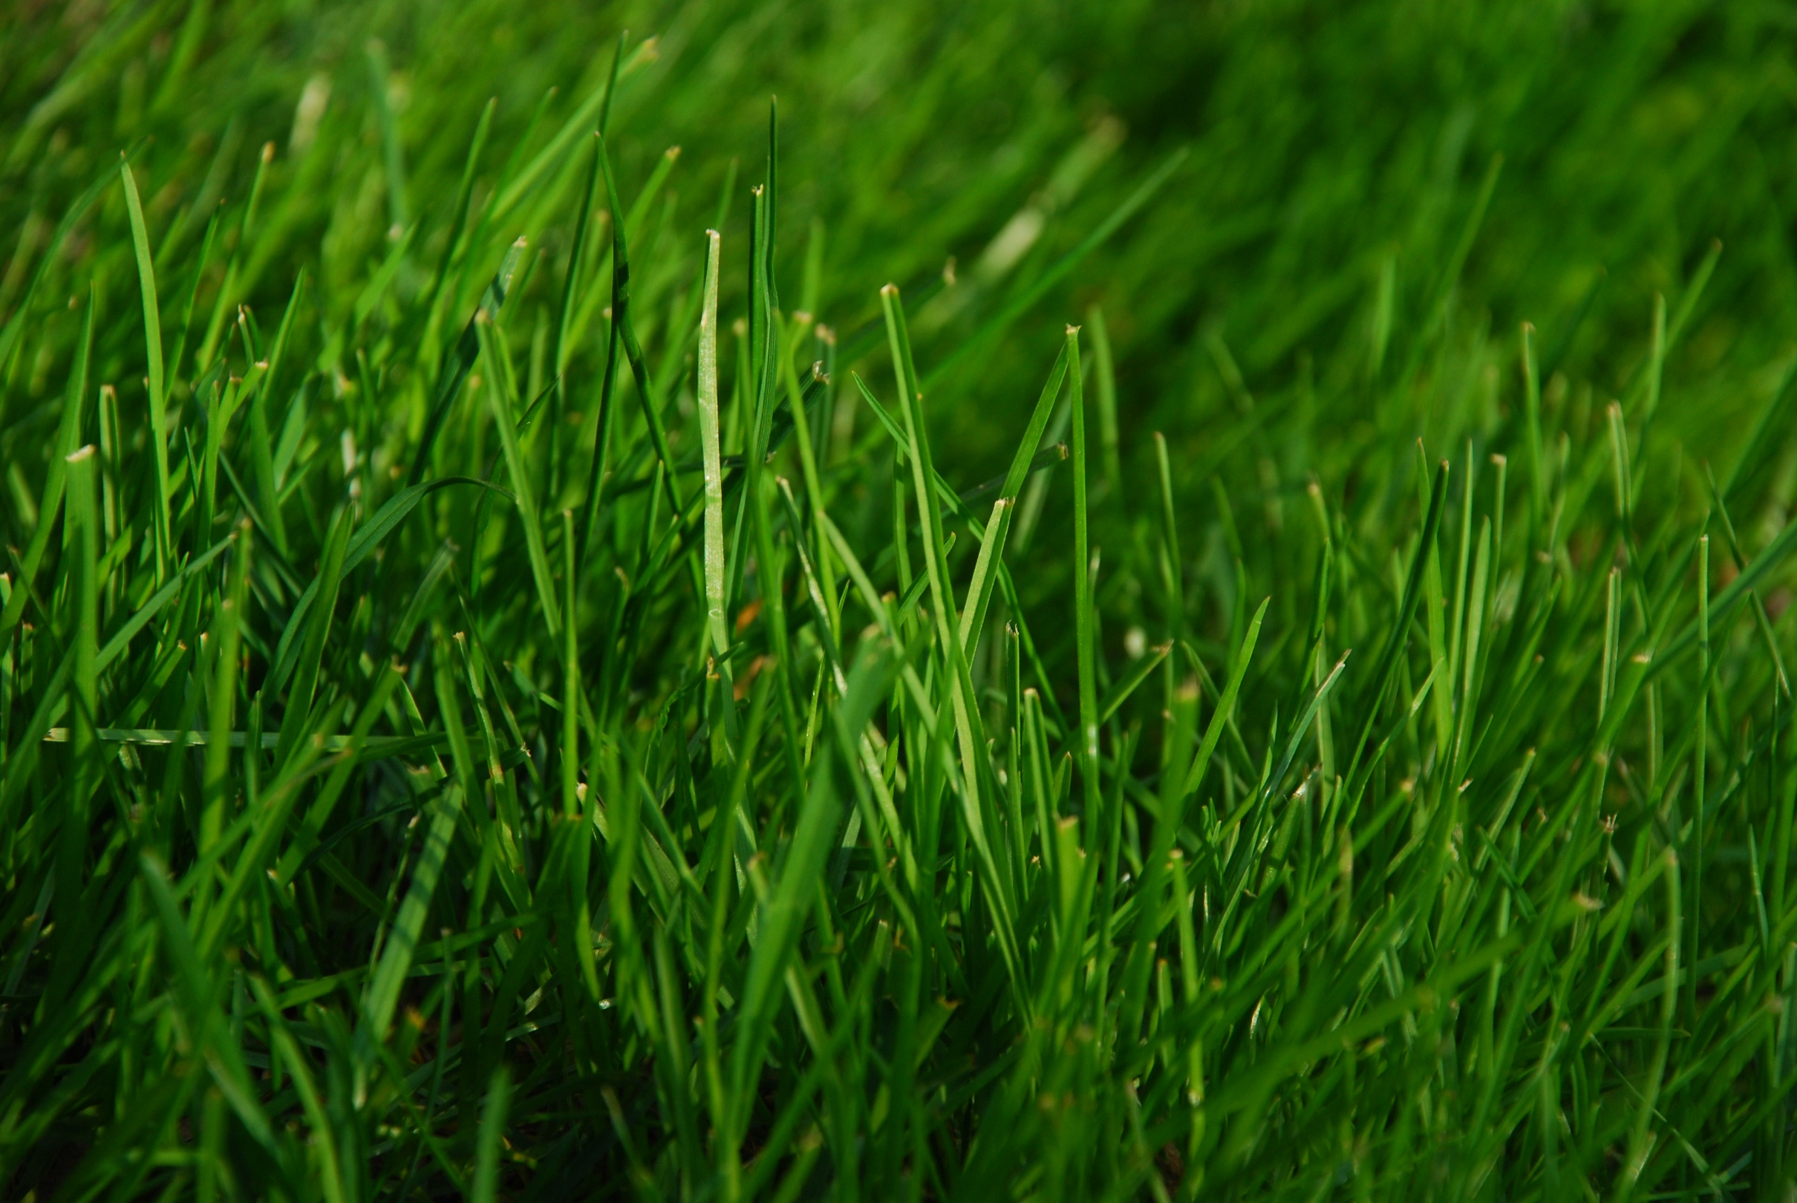
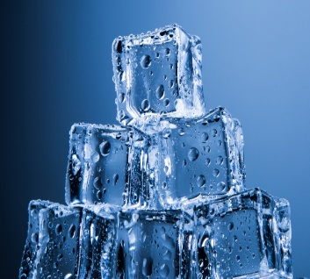
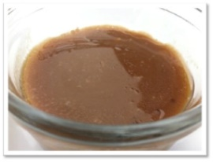
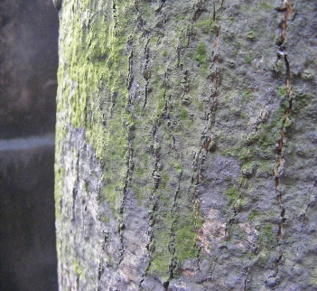
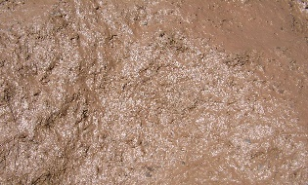
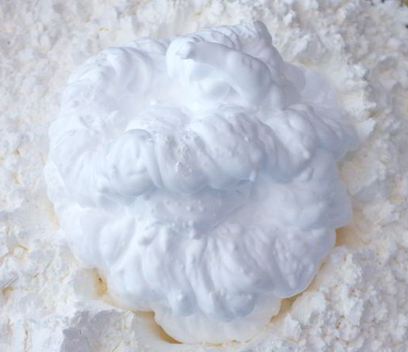
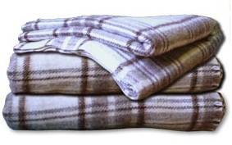
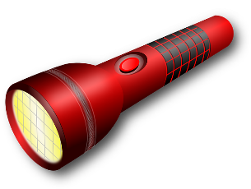
For this story, you will need:
Bear
Drum for repeated pages
Grass
Ice for the river
Gravy or real mud for mud
Bark for the forest
Look out for the pictures so you know when to use each item.
Shaving foam for the snow
Blanket and torch for the cave
Blanket to wrap up in as the bed

Slide 2
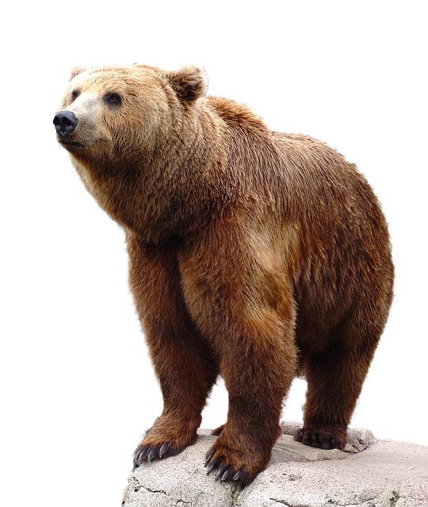
We’re Going on a Bear Hunt

Slide 3
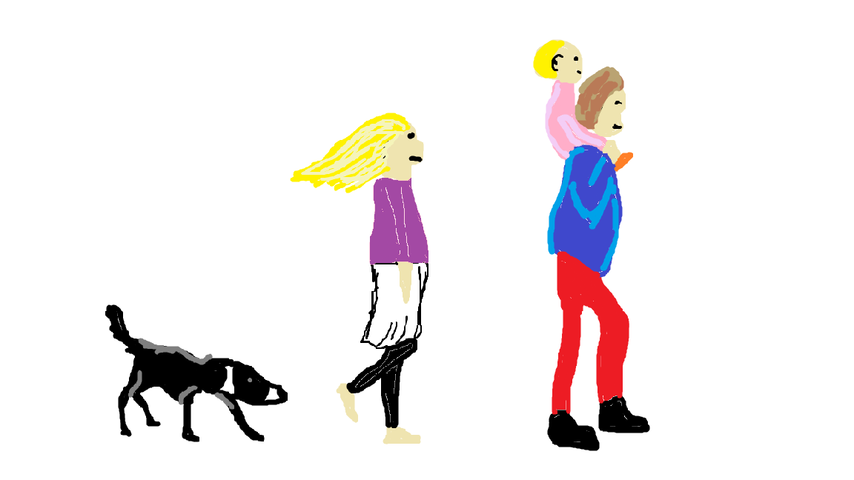
We’re going on a bear hunt.
We’re going to catch a big one.
What a beautiful day.
We’re not scared.

Slide 4
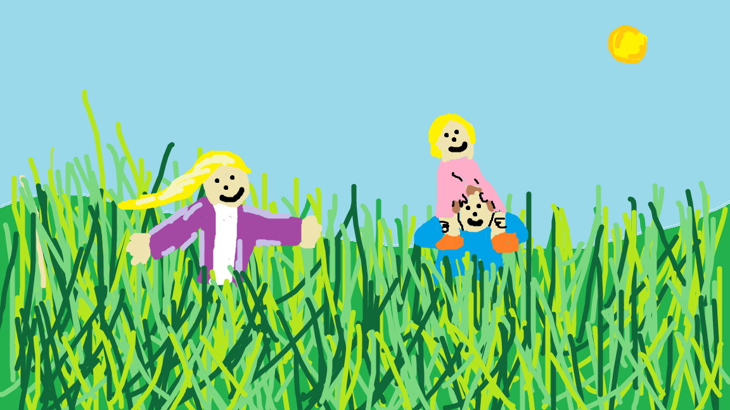
Oh no, grass!
We cant go over it, we cant go over it.
We’ve got to go through it!

Slide 5
We’re going on a bear hunt.
We’re going to catch a big one.
What a beautiful day.
We’re not scared.

Slide 6
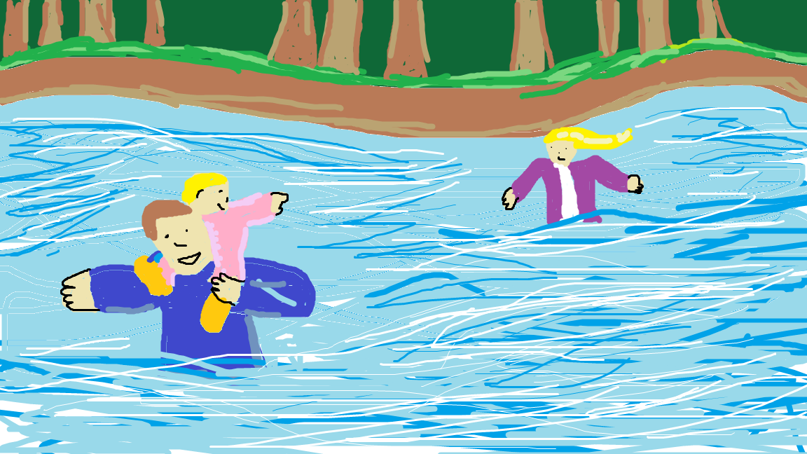
Oh no, a river!
We cant go over it, we cant go over it.
We’ve got to go through it!

Slide 7
We’re going on a bear hunt.
We’re going to catch a big one.
What a beautiful day.
We’re not scared.

Slide 8
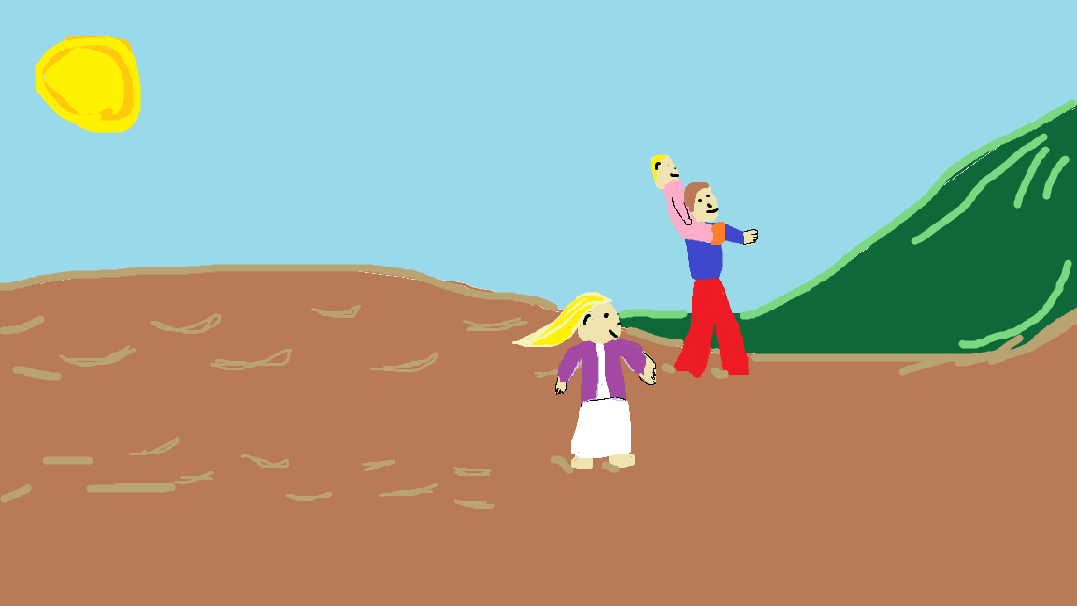
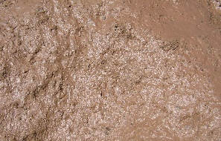
Oh no, mud!
We cant go over it, we cant go over it.
We’ve got to go through it!

Slide 9
We’re going on a bear hunt.
We’re going to catch a big one.
What a beautiful day.
We’re not scared.

Slide 10
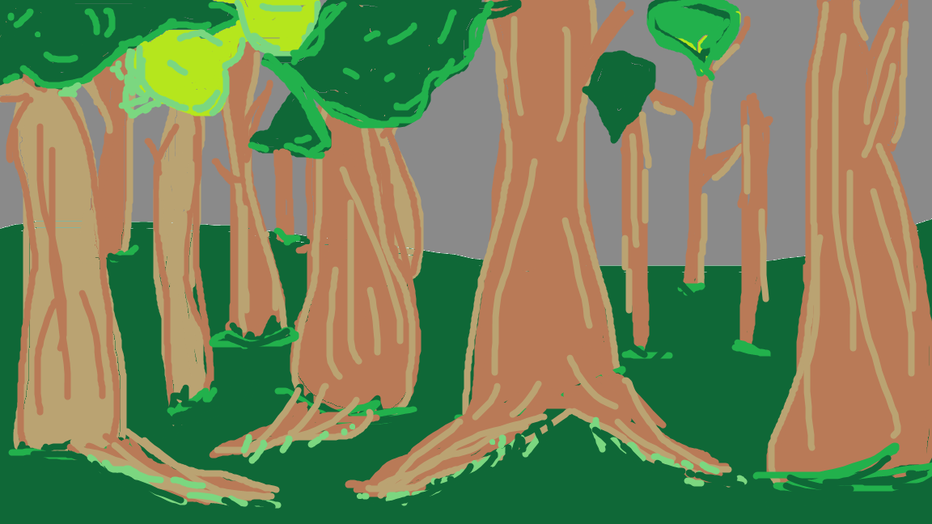
Oh no, a forest!
We cant go over it, we cant go over it.
We’ve got to go through it!

Slide 11
We’re going on a bear hunt.
We’re going to catch a big one.
What a beautiful day.
We’re not scared.

Slide 12
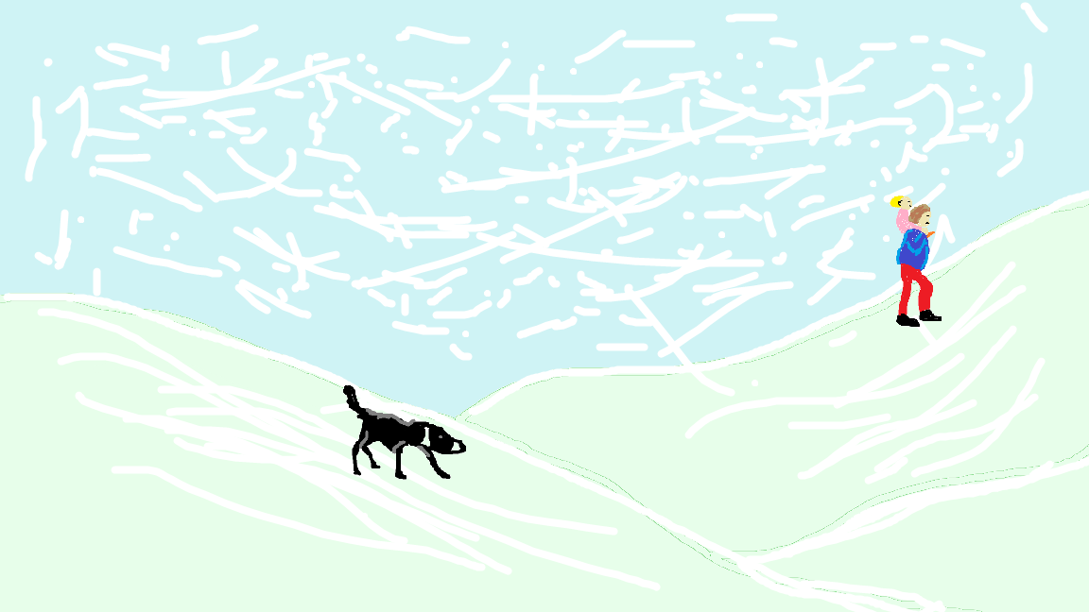
Oh no, a snowstorm!
We cant go over it, we cant go over it.
We’ve got to go through it!

Slide 13
We’re going on a bear hunt.
We’re going to catch a big one.
What a beautiful day.
We’re not scared.

Slide 14
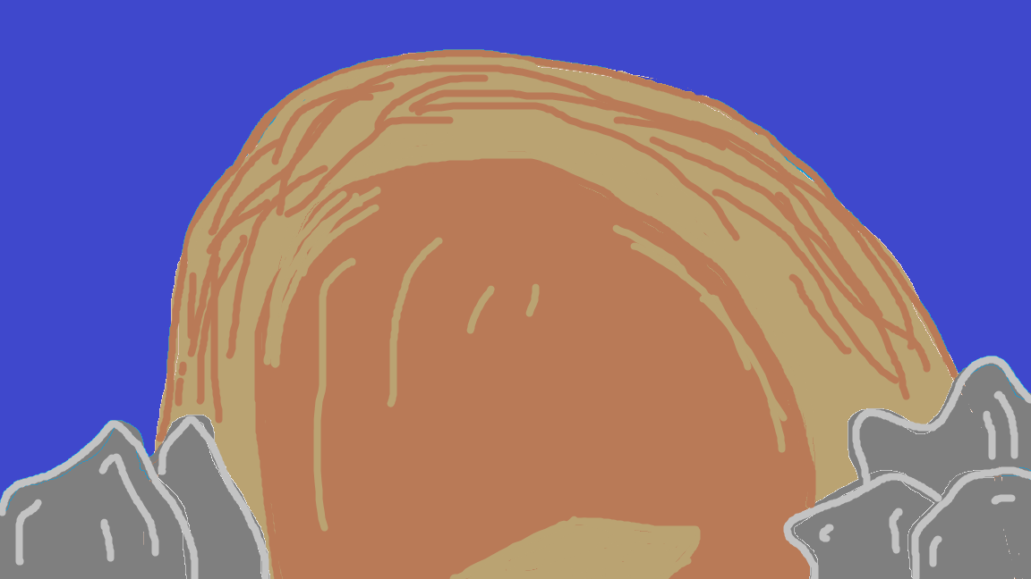
Oh no, a cave!
We cant go over it, we cant go over it.
We’ve got to go through it!

Slide 15
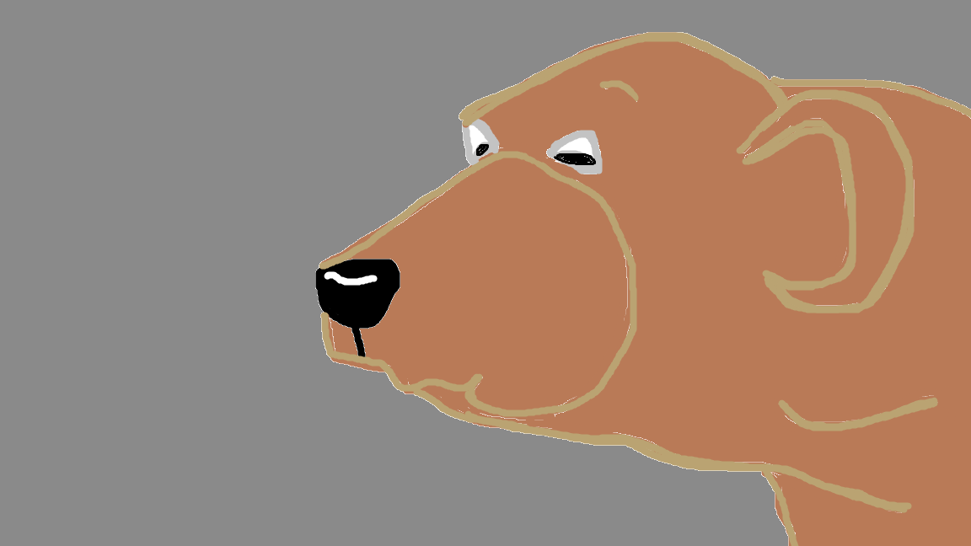
1 shiny wet nose.
2 big eyes.
2 big furry ears.
IT’S A BEAR!

Slide 16
Quick! Back through the cave.
Quick! Back through the snowstorm.
fast

Slide 17
Quick! Back through the forest.
Quick! Back through the mud.
fast

Slide 18
Quick! Back through the river.
Quick! Back through the grass.
fast

Slide 19
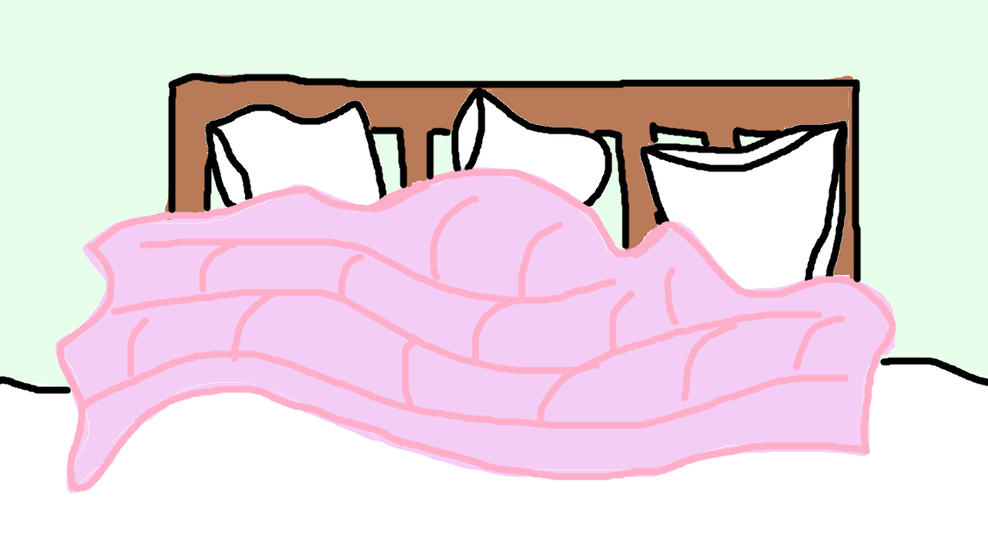
We’re not going on a bear hunt again.

