Slide 1
Leisure Strategy
Encouraging active lifestyles and enjoying our surroundings

Slide 2
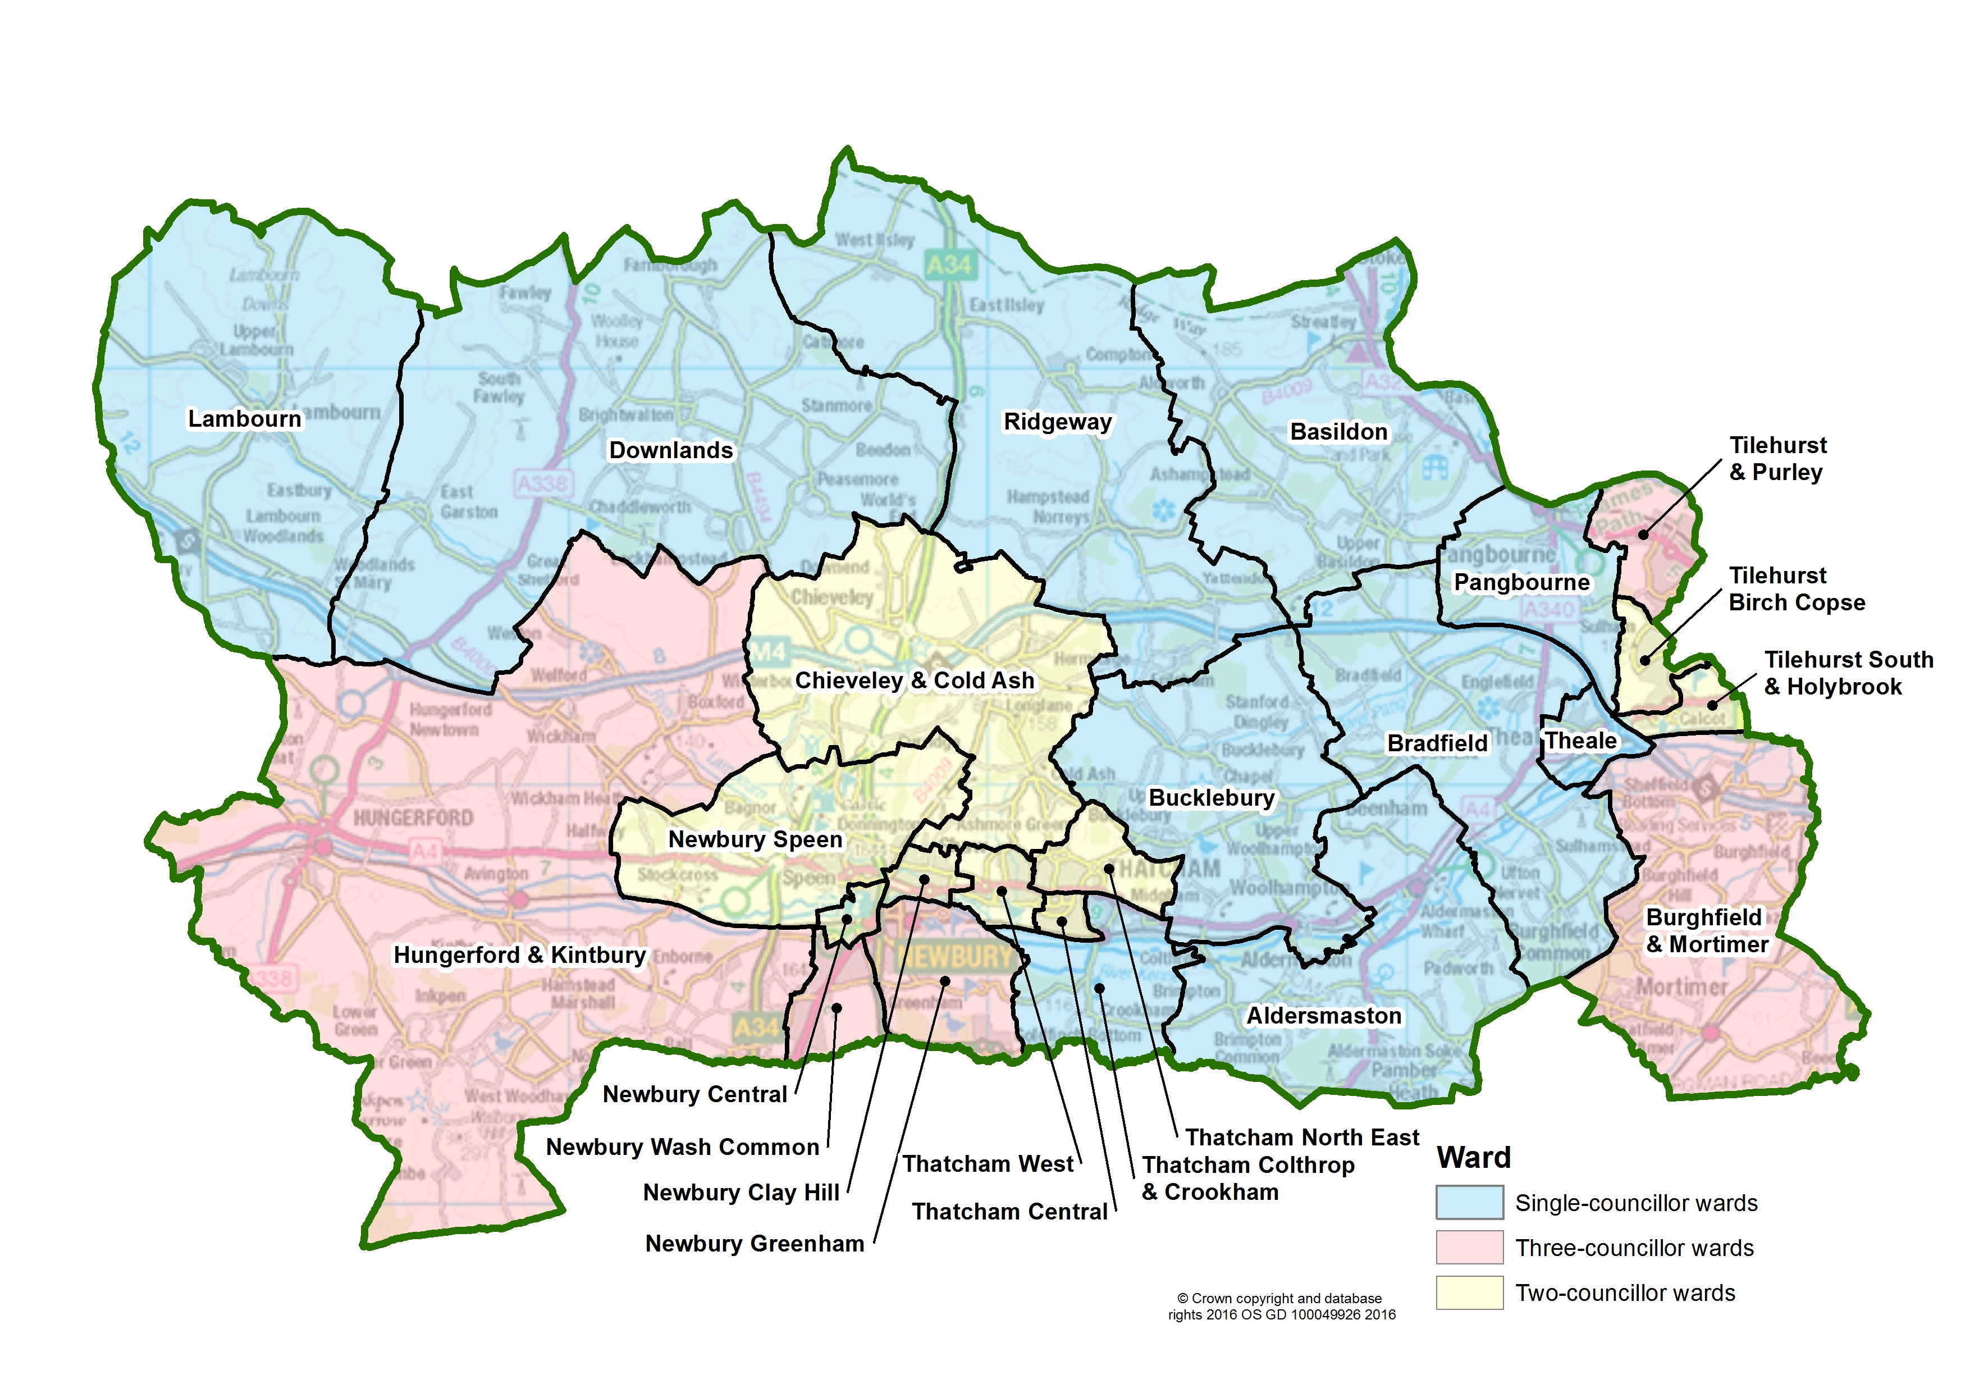
Understanding our communities

Slide 3
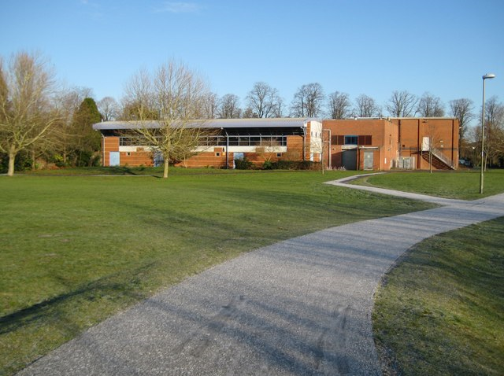
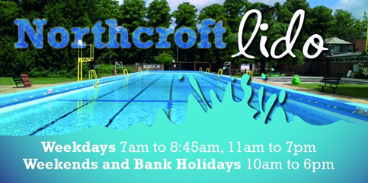
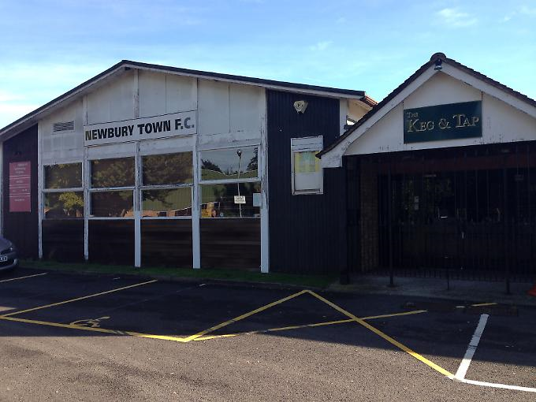
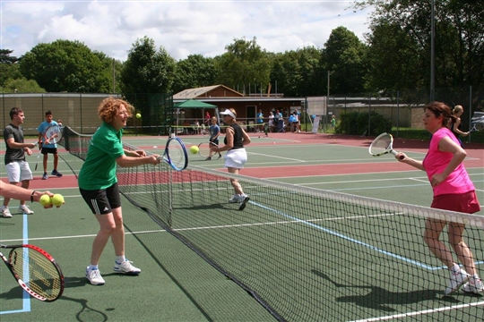
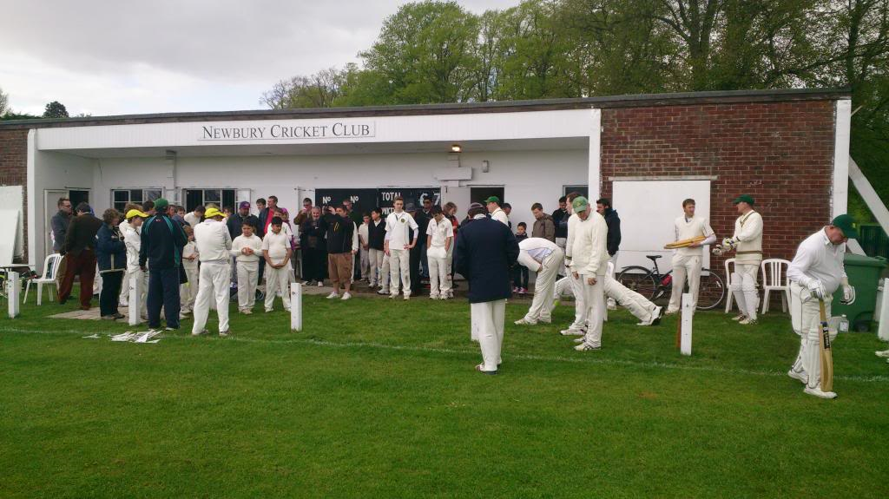
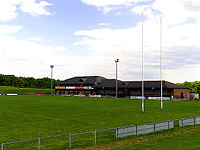
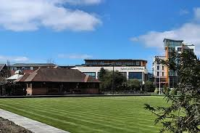
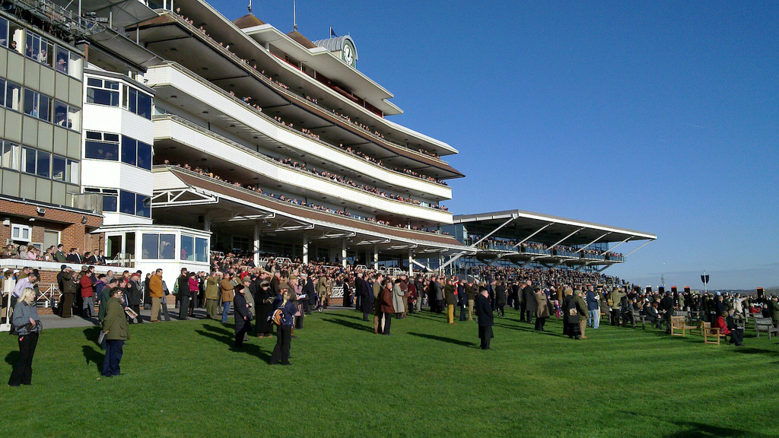
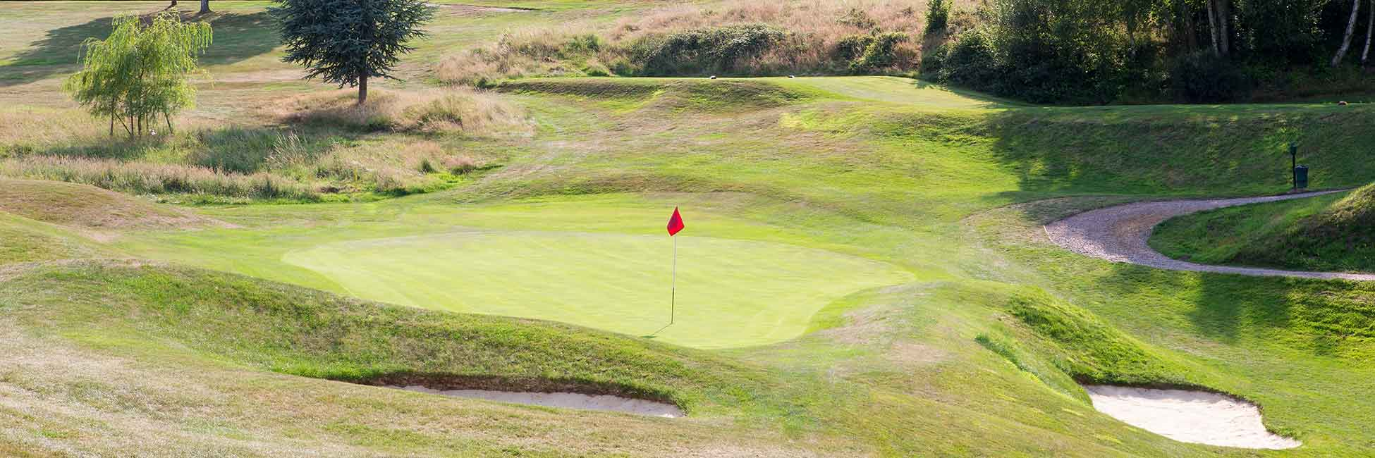
Focal Points

Slide 4
Asking the right questions
Do we actually know what our communities want to do?
What role should the Council play in our local leisure network?
Have we got strong links with our local leisure networks?
What opportunities are there for accessing funds to invest in Leisure?

Slide 5
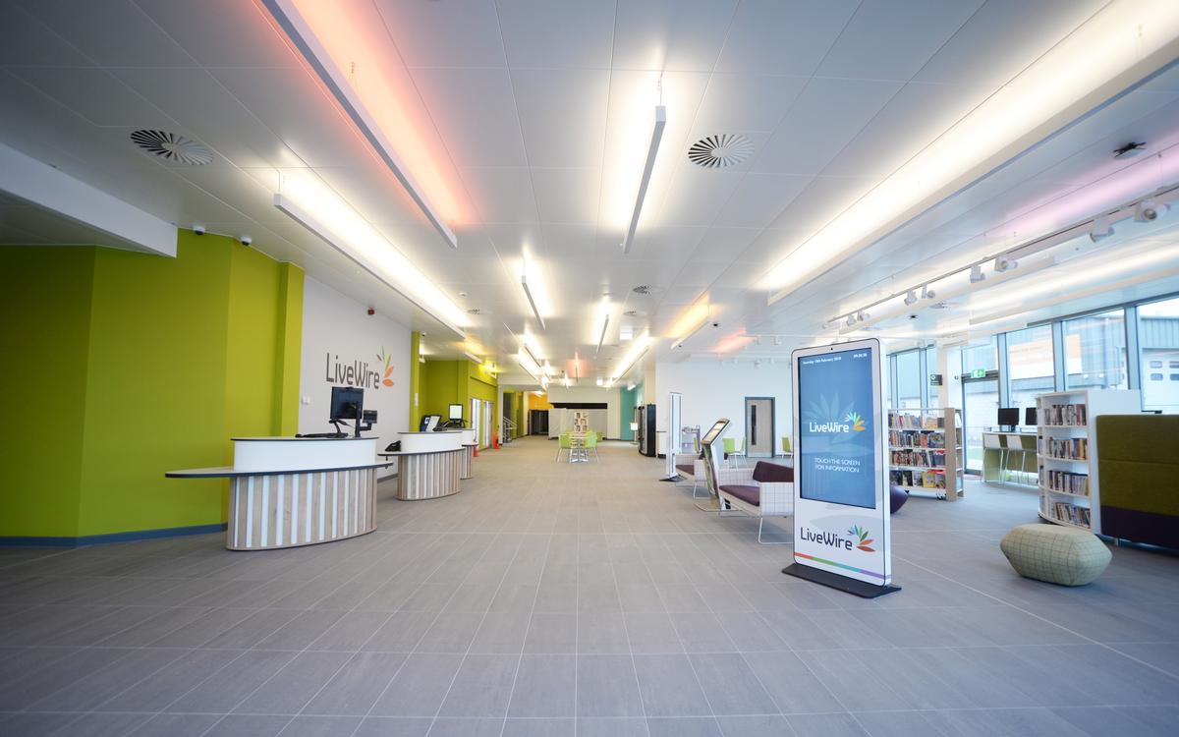
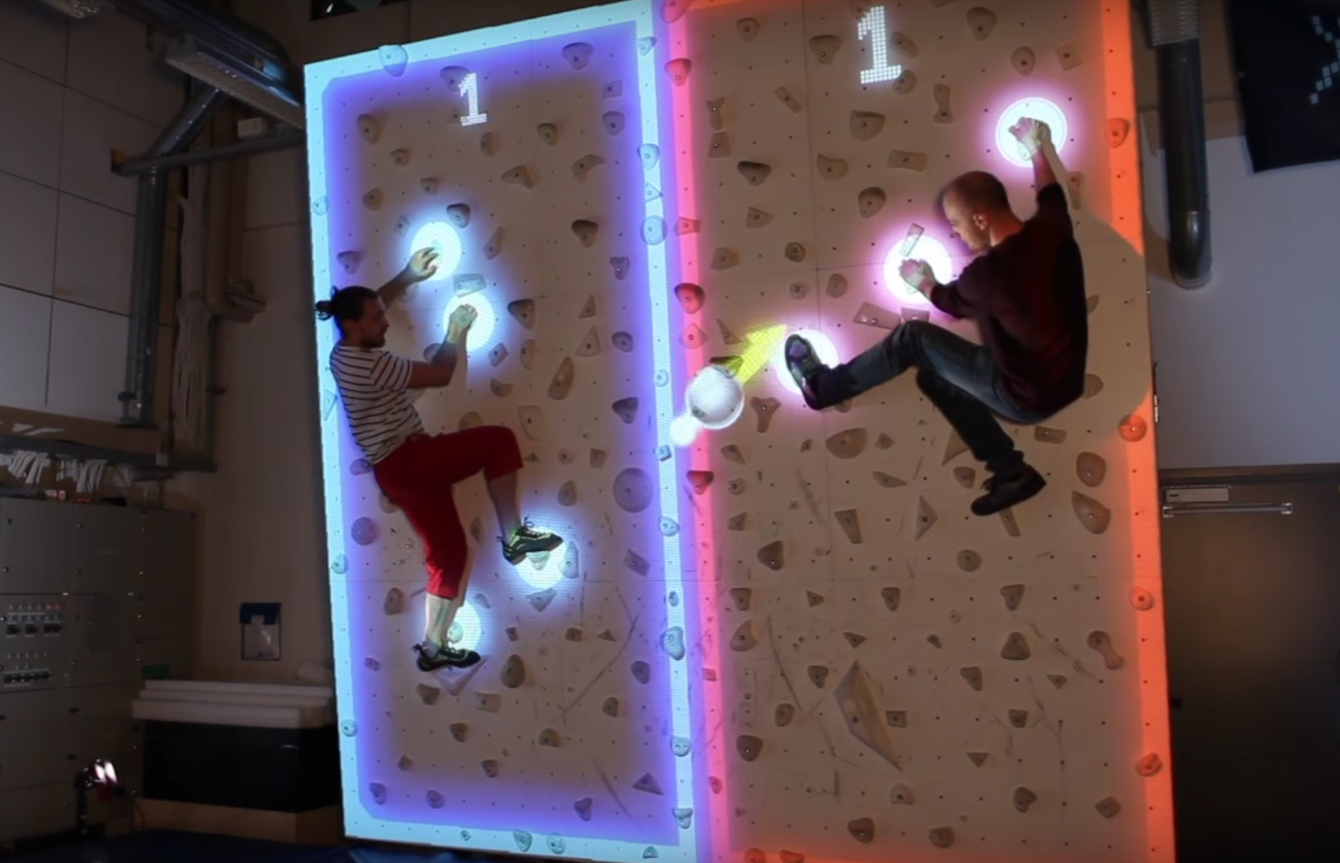
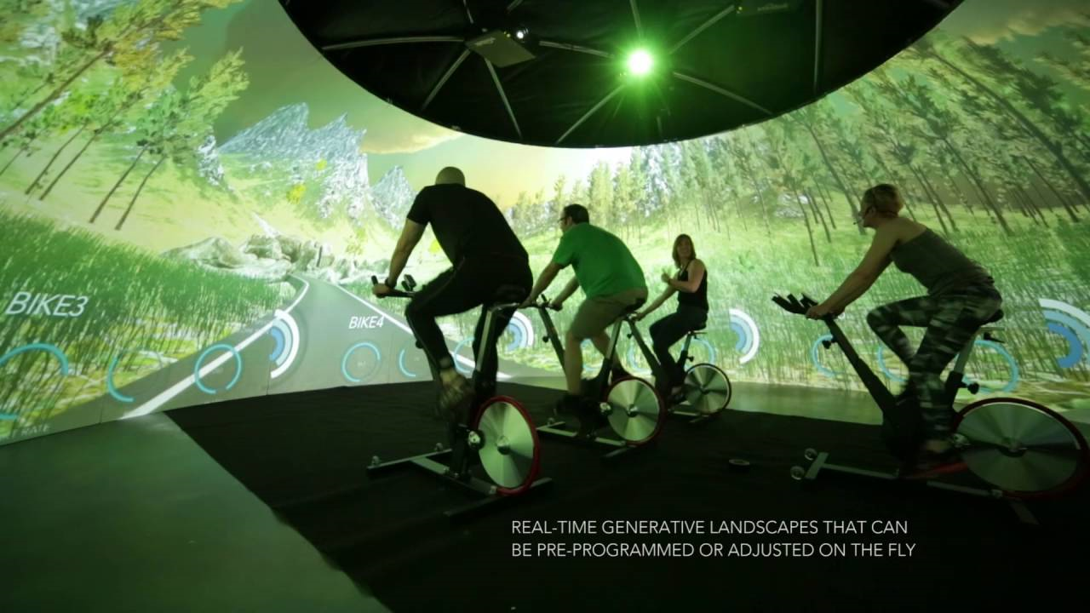
Leisure Facilities – the future
Embedding technology
Dementia friendly

Slide 6
Outdoor Spaces
Challenges around accessibility
Connectivity between places
Development of artificial grass pitches
Managing demand
Balancing Leisure with Bio-Diversity

Slide 7


Working with the Health Sector
Understanding complex health needs
Supporting initiatives that improve quality of life
Preventative agenda – using leisure as part of the solution

Slide 8
Future Development

Slide 9
And for Newbury
Building on Newbury 2026 and the Newbury Town Plan
Review current provision for Sport and Leisure across the area
Rationalise existing provision and identify potential enhancements
  E.g. Northcroft Leisure Centre built in the 1970’s and Northcroft Playing Fields – explore the potential of new opportunities or enhanced provision.
    Can new facilities be included at the leisure centre through regeneration e.g. clip and climb, health monitoring, immersive studios.
    Shared club house facilities to support football and cricket – could Newbury Town FC relocate to this area?
Will form part of the consultation on the Leisure Strategy

Slide 10
The start of something……
If you or your organisation want to be part of this conversation please contact me
Paul Anstey
Head of Public Protection and Culture
Paul.Anstey@westberks.gov.uk
THANK YOU

